Slide 1

The Pearl Initiative creating a corporate culture of transparency and accountability
Capital Markets Authority Kuwait
Corporate Governance Symposium
2nd February 2013

Slide 2

Pearl Initiative
“Developed by the private sector for the private sector;
within the region for the region.
This is the unique approach of the Pearl Initiative”.
Not-for-profit
GCC wide
UN cooperation
Driving programmes since mid-2011
Offices hosted at American University of Sharjah

Slide 3


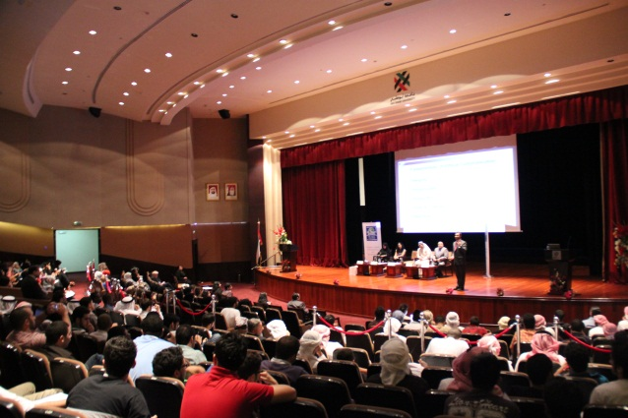
Accountability and Transparency
Collaborative
Programmes &
Dialogue Forums
Knowledge
Creation
University
Collaborations
Corporate governance
Reporting
Responsible business practices
Anti-bribery and corruption

Slide 4

Towards Better Corporate Practices in the Region
Reinforcement of positive incentives and messages
The business case – good governance enables long-term direct value creation
Raising awareness; influencing mindsets
Research, analyse and showcase regional good practices; learn from these experiences
Private sector taking up the mantle and showing the investment community that the region is a safe, long term investment proposition

Slide 5

Family Matters
Governance Practices in GCC Family Firms
Interviews with over 100 family firms across the GCC
Aims:
  Raise awareness and understanding on governance issues, trends and existing practices in GCC family firms
  Enable family firms to benchmark their own business against others in the region
Increasing confidence and willingness to share practical insight on topics not viewed as too confidential or competitive

Slide 6

Report covers
Key Issues and Priorities
The Board
  Board Committees
  Performance Evaluation
Family Governance
Transparency
Accountability

Slide 7
Key Issues and Priorities
“The key drivers to improve governance and
transparency are linked to the desire to develop and eventually pass on a healthy and efficient organisation.”
Recognise importance of corporate governance;
implementation is an issue
Succession, conflict and continuity
Management and control
Separating “family” from “business” concerns
Formalisation of structures, rules and processes
“We must move from an oral tradition to one in which rules and guidelines are written down so that they can be referred to.”
“A strong well-functioning
Board acts as the right
interlocutor between the
family and the company.”

Slide 8
The Board
“[The challenge is the] ability to distinguish between management, owner, and the Board. To get the Board to function as a proper Board.”
51% have a non-exec Board Chairman
85% have the CEO on the Board
15% have non-family shareholders
85% have family in Senior Exec roles
56% of Boards have no specified term

Slide 9

Independent Directors
“The family will make the decisions at the end of the day. But they should not be making key decisions ad hoc outside of the Board. This is why we want to add independent directors – to add discipline, strategic focus and structure – so we can’t by-pass the Board or cancel Board meetings at the last minute.”
“The identification and selection of non –family non-executive directors is critical. They must be willing to commit time, they must be trusted and they must get to know the business intimately. Industry knowledge is not a criterion. More important is strategic skills, corporate governance, legal and finance skills.”
“Bringing in non-family members changes the dynamics on the Board.”

Slide 10
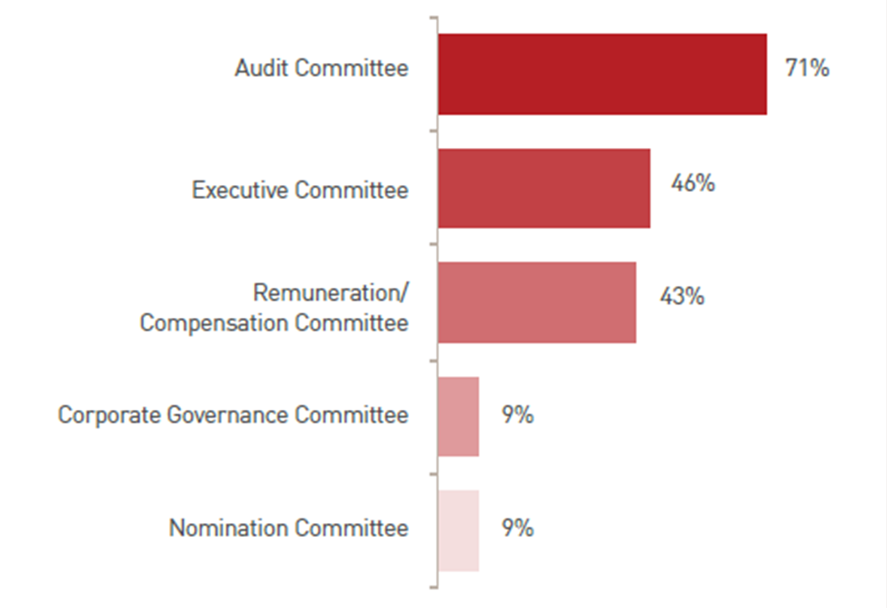
Board Committees
Graph from page 18:
Percentage of family firms with Board committees in place

Slide 11
Performance Evaluation
“There is no point in evaluating the Board. If a family member owns 20% of the company, you cannot kick him off the Board, even if he adds little value to it.”
Only around 4% of family firms evaluate Board performance
A sensitive issue – the potential to negatively affect family dynamics

Slide 12
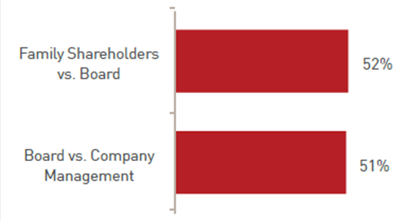
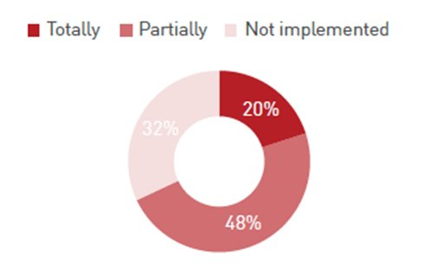
Family Governance
“There is a mind-set change between the older members of the family and the younger members. Formalising family governance and rules helps document values and systems and retain the close bond across the generations.”
“Half this generation’s family members are involved in the business; next generation it will be only 20%. So we must have clear criteria for selection of family members, and well-thought out structured governance and transparency for those not directly involved.”
52% have defined responsibilities, but only 20% fully implemented
37% have a Family Council

Slide 13
Transparency
Strong culture of privacy
Increasing communication across family
Raising external finance
Requirements from multinational partners
“There is no business case for public disclosure by a family business – it would be like opening up our private bank account.”

Slide 14
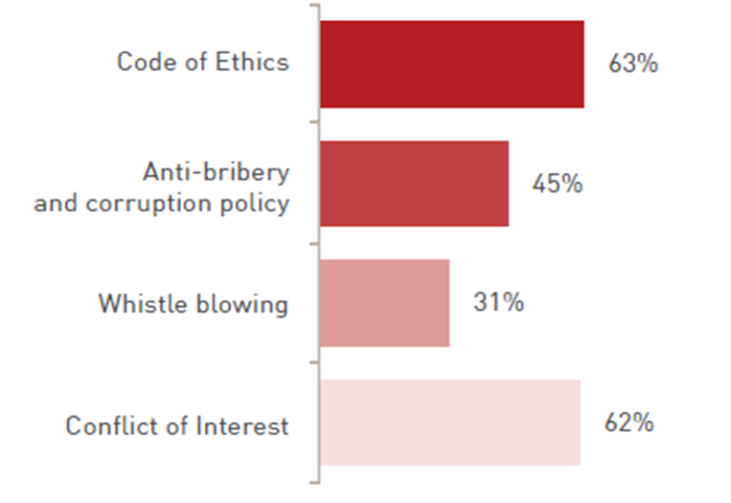

Accountability
Policies in Place
Implemented in Practice

Slide 15
Conclusions
“The practical aspects of
implementation are likely to be a challenge.”
Increasing professionalism and international competitiveness
Awareness of increasing importance of corporate governance but not a high strategic priority
Almost no Board performance evaluation
Key family issues: succession and the management of conflict
Difficulties in implementing better family governance
Increasing strategic family communication
Very little public disclosure

Slide 16

Pearl Initiative: 2013 Workplan
Series on GCC corporate good practice case studies:
  Effective Boards
  Family Firms
Business Leader Roundtables
Universities
  Case Study Competition
  Workshops

Slide 17
The Pearl Initiative creating a corporate culture of transparency and accountability
Imelda Dunlop
Executive Director
idunlop@pearlinitiative.org
Office +971 6 515 4605

