Slide 1


Sustainability in Capital Markets
Abdulrahman Yousef Alfailakawi, Director of Markets Regulation
Rayan Sameer Saeed, Analyst
Markets Regulation Department
Capital Markets Authority

Slide 2




Sustainability/ESG Issues
Environmental | Social | Governance
Climate Change | Working Conditions | Board Structure
Stress on Natural Resources | Labor Rights | Business Ethics
Pollution | Human Rights | Executive Pay
Waste | Human Capital | Reporting & Transparency
 | Stakeholder Opposition
 | Product Liability

Slide 3




Deep Dive: Environmental Issues
Climate Change
Pressure on
Natural Resources
  Extreme weather events
  Global warming (main driver is gas emissions i.e CO2)
  Costly to mitigate or adapt with (Paris Agreement)
  Plants and animals (biodiversity)
  Fresh water
  Metals and minerals
Pollution
Waste
  Harms the environment and living species.
  10% of all deaths!
  Harms the environment and living species.
  Solutions could save costs (recycling)

Slide 4




Deep Dive: Social Issues
Working Conditions
Labor Rights
  Health & safety.
  Rana Plaza incident
  Minimum wage, child labor, equal pay.
  Right to organize (unions)
Stakeholder Opposition
Product Liability
  Companies know their products more than customers
  Legal repercussions
  Engage with the community
  Communicate with transparency

Slide 5




Deep Dive: Governance Issues
Board Structure
Business Ethics
  Skills
  Diversity
  Independence
  Culture that supports governance.
Executive Pay
Reporting
  Must be disclosed to shareholders
  Fixed pay / bonus /
  stock-based
  Integrity of financial statements
  Audit committee

Slide 6

Why Do We Regulate Sustainability?
Sustainable investments has gained prominence and are set to expand further to meet future commitments.

Slide 7
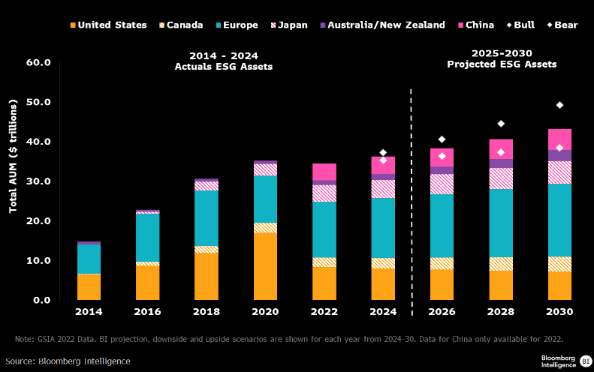
Investing in Sustainable Assets
Sustainable investing to reach $35 trillion in AUM by 2030, comprising over 25% of total AUM. (Bloomberg)

Slide 8
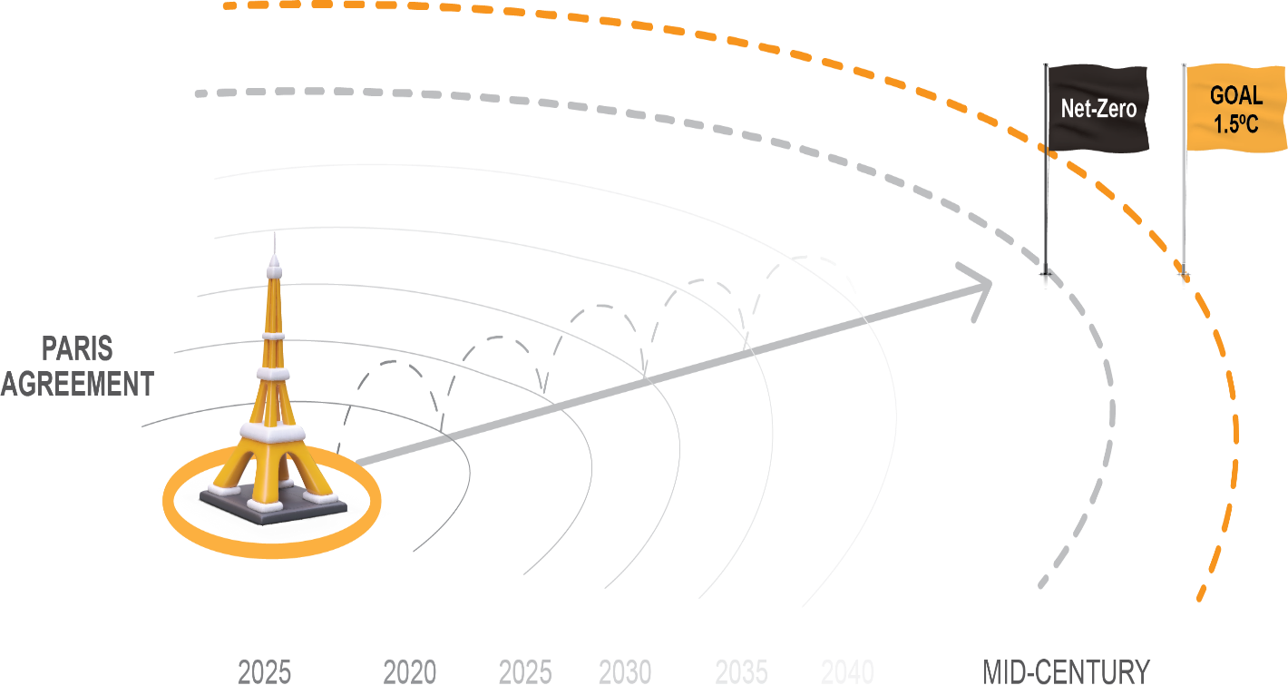
Investing in Sustainable Assets
  $4T annually to reach net zero emissions (2030-2050) –
  Source: International Energy Agency (IEA)

Slide 9

Investing in Sustainable Assets
75% of institutional investors incorporate ESG factors into their investment processes.
(MSCI Survey)
77% of retail investors are interested in sustainable investing. (Morgan Stanley 2024)

Slide 10




Why Do We Regulate Sustainability?
More details – Next slide
44% of global investors think that corporate reporting contains unsupported claims (PwC Survey-2024);
1,841 incidents of misleading communication were recorded in 2024, 56% of it were linked to environmental issues (greenwashing);
High-risk incidents surged by 30% in 2024. (RepRisk)
WEF Global Risks Report 2024:
  5 of the top 10 global risks over the long-term are Environmental.
  2 of the top 10 global risks over the longer-term are Societal.

Slide 11
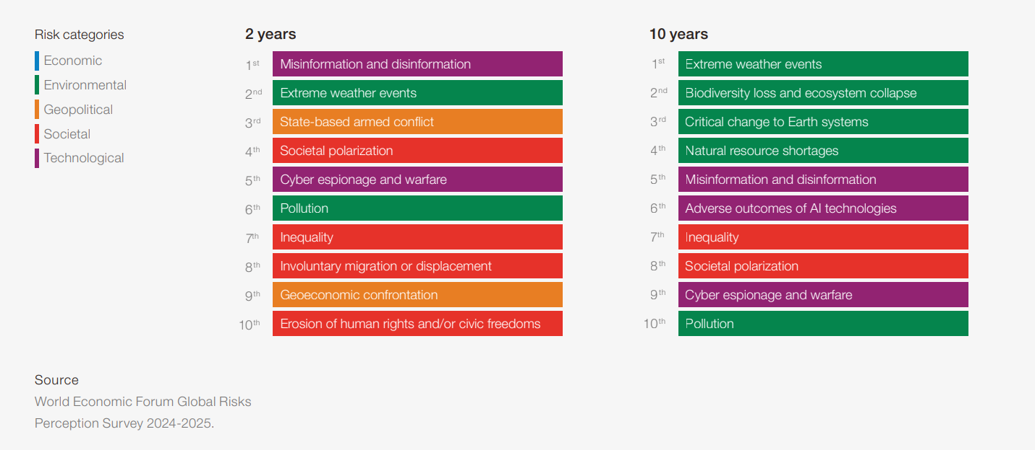
Why Do We Regulate Sustainability?

Slide 12






Why Do We Regulate Sustainability?
PROTECT INVESTORS
AVOID SYSTEMIC RISK
ENSURE TRANSPARENCY
RepRisk-2024

Slide 13
Recent Regulatory Updates
Cumulative number of in-force sustainable finance policies in Hong Kong, Singapore and G-20 markets continues rise!
Source: Bloomberg Research Q4 2024

Slide 14









Recent Regulatory Updates
International Financial Reporting Standards IFRS) Sustainability Disclosure Standards (ISSB Standards)
Provide unified reporting standards for investors. Effective, January 2024 (jurisdiction based)
European Union's Corporate Sustainability Reporting Directive (CSRD)
Mandatory, effective January 2024, set to impact 50,000 companies across the European Union.
U.S. Securities and Exchange Commission (SEC) Climate Disclosure Rules
Effective in March 2024, public companies are required to disclose all material climate related risks, and greenhouse gas emissions.
Hong Kong Exchanges and Clearing Limited (HKEX) Rules
New disclosure rules aligned with ISSB, effective January 2025.
Australian Mandatory Climate Reporting
Starting January 2025, Australia requires over 1,800 companies to disclose climate-related financial risks

Slide 15


Kuwait's Commitment to Sustainability: Net-Zero Goals, SDGs, and Evolving Market Dynamics
Net-Zero Commitments
The government has pledged to reach net-zero emissions in the oil and gas sector by 2050 and by 2060 for the whole country.
Public markets can provide an enabling environment to fund sustainable initiatives.
SDGs Contributions
Kuwait committed to contributing to the Sustainable Development Goals (SDGs), contribution is incorporated in pillars established in Kuwait Vision 2035.

Slide 16
CMA’s Regulatory Framework on Sustainability
Reporting Requirements
Governance
(Board Level)
Mutual Funds
Voluntary;
Internationally recognized reporting standard/s;
Engage stakeholders;
Material topics;
Third-party assurance is allowed.
Integration of ESG issues into operations (where needed);
Include sustainability factors in strategic planning;
Incorporate sustainability risks into overall risk management and assessment
Definition of sustainable (ESG) fund;
Conditions: alignment with sustainability goals, inclusion of ESG factor/s, ESG investing approach
Report confirming alignment

Slide 17
Observations – Sustainability Reporting
Clear Disparity Between Market Segments
Variations in the Timing of Disclosures
Positive Trends in the Premier Market
A noticeable gap exists between premier and main market issuers in terms of sustainability reporting practices.
Sustainability reports are being published in different times around the year by issuers.
Within the premier market segment, companies have demonstrated both the capability and a proactive approach toward publishing detailed and transparent sustainability reports, as evidenced by recent survey findings.

Slide 18

Observations- Sustainability Reporting
Report Submission Rates:
Nearly, 70% of premier markets issuers published sustainability reports in 2024.
Only 5% of main markets issuers published sustainability reports in 2024.
GRI is the most used reporting standards, followed by SASB.
65% of reports are assured by third-parties
65%

Slide 19

Observations- Sustainability Reporting
Majority of companies integrate or in the process of integrating sustainability into their business

Slide 20
Observations- Sustainability Reporting
Although majority willing to integrate and disclose sustainability reports, there are some common challenges among companies.

Slide 21




Expectations – Sustainability Reporting
Gradual move from voluntary to mandatory schemes
  Positive survey results
Unifying reporting period
  Relevance of information declines with time
  Investors look for timely, consistent disclosures
  Ideally coincides financial reporting
ISSB Standards Adoption
  CMA joined IOSCO’s GEMC ISSB Adoption Network (31 jurisdictions in total)
  Currently developing a roadmap to adopt the standards.
  Mandating other well recognized standards (GRI, SASB, TCFD) should facilitate implementation of ISSB standards.
Assurance for Sustainability Reporting
  Heightened attention on reliability and credibility by investors (and other stakeholders)
  If mandated, might also be implemented in a phased approach (premier vs main, limited vs reasonable)
  International Ethics Standards for Sustainability Assurance (IESSA).

Slide 22
Evolving market dynamics, rising investor focus, and global sustainability goals are driving constant updates to regulations.
Regulations are the baseline for transparency but should not be the starting point for integration.
Sustainability is voluntary, but its value is undeniable.
The CMA is committed and is likely to release its first sustainability report next fiscal year report.
Closing Thoughts and Key Takeaways

Slide 23
THANK YOU!

