Slide 1
THE Role of Regulators to limit financial statements’ frauds

Slide 2
Introduction
Financial Statements Frauds are considered one type of financial frauds, which can be used by some companies to manipulate investors into investing in those fraudulent companies.

Slide 3
Definition of Financial Statements Frauds
Motivations for committing financial statements frauds
Methods of financial statements frauds
Role of Regulators to limit financial statements’ frauds
Corporate Governance regulations
Oversight over supervised entities
Implementing strict sanctions and penalties
Awareness

Slide 4
Definition of Financial Statements Frauds
What do we mean by financial statements?
What is the purpose of financial statements?
What is financial statements fraud?

Slide 5
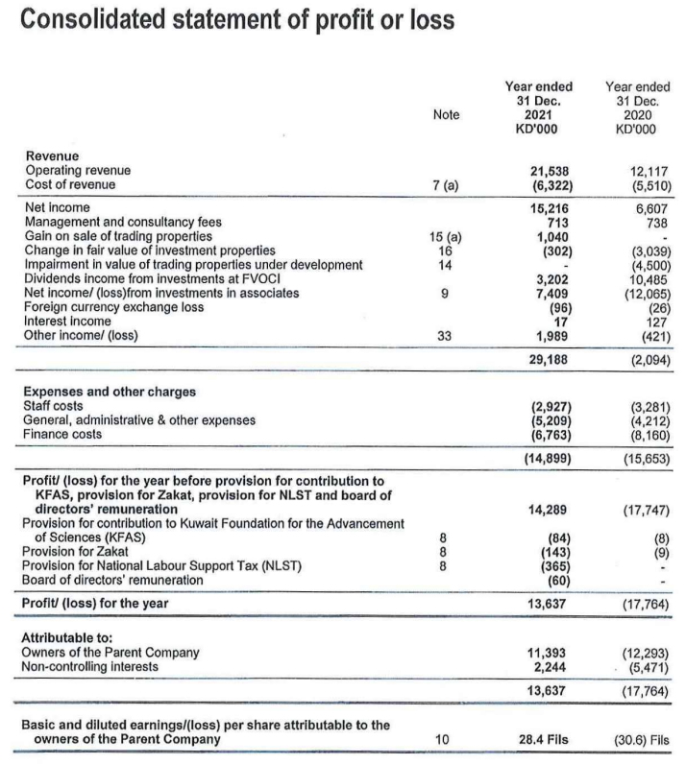
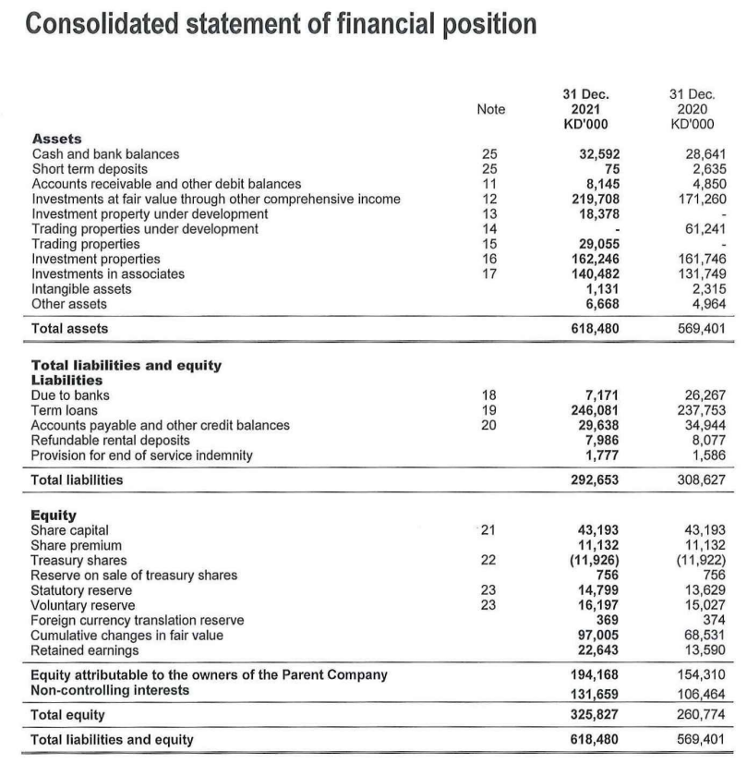
Definition of Financial Statements Frauds
What do we mean by financial statements?
Written reports that describe a company’s activities and its financial performance.

Slide 6
Definition of Financial Statements Frauds
What is the purpose of financial statements?
to reach the correct investment decision/analysis about the company
A doctor needs patient’s data and information in order to properly diagnose the patient
The investor needs company’s financial statements to make the correct investment decision about the company

Slide 7
Definition of Financial Statements Frauds
What is the purpose of financial statements?
Examples of analyzing financial statements

Slide 8
What is financial statements fraud?
Preparing financial statements that include incorrect information in order to manipulate the investors and the users of the financial statements

Slide 9
Motivations for committing financial statements frauds

Slide 10
Motivations for committing financial statements frauds
Getting financed by banks or investors
Complying with regulatory requirements
Personal gains.
Tax evasion.

Slide 11
Methods of financial statements frauds

Slide 12
Methods of financial statements frauds
Manipulating of assets valuations
False transactions
Manipulating the timing of transactions
False Disclosures

Slide 13
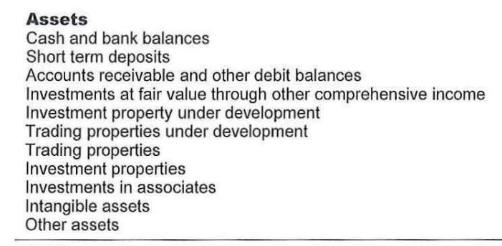
Methods of financial statements frauds
Manipulating of assets valuations

Slide 14
Methods of financial statements frauds
Incorrect recording of assets
Incorrect recording of revenue
False transactions

Slide 15
methods of financial statements frauds
Acquiring new contracts with clients
Manipulating the timing of transactions

Slide 16
methods of financial statements frauds
Incorrect disclosures about the real status or details of company’s transactions
False Disclosures

Slide 17
Role of Regulators to limit financial statements’ frauds

Slide 18
role of Regulators to limit financial statements’ frauds
Corporate Governance regulations
Oversight over supervised entities
Listed companies and licensed companies
Registered External Auditors
Implementing strict sanctions and penalties
Awareness

Slide 19
Corporate Governance regulations
Insuring the accuracy of financial statements
Holding the board of directors and executive management accountable for the accuracy of the financial statements
The independence and high qualifications of the audit committee
The continues meetings between the audit committee and the external auditors

Slide 20
Oversight over supervised entities
Listed companies and licensed companies
On-Site Supervision
Off-Site Supervision
Performing on-site inspections to check for companies’ compliance with corporate governments regulations regarding the accuracy of the financial statements, and the effectiveness of the implemented internal controls
Reviewing the financial statements to insure their compliance with the international accounting standards and other regulatory requirements

Slide 21
Oversight over supervised entities
Registered External Auditors
Reviewing and examining a sample of audit engagements that were performed by the external auditor, to insure their compliance with the international auditing standards
Reviewing and examining quality control policies and procedures:
Leadership responsibilities
Ethical requirements
Monitoring
Human resources
Engagement performance
Acceptance & continuance of client engagements
Documentation

Slide 22
Implementing strict sanctions and penalties
The inclusion of strict sanctions and penalties within the CMA regulations regarding the inaccuracy of the financial statements.

Slide 23
Awareness
The development of the general understanding of financial statements for the investors and the users of the financial statements.
Awareness regarding the most recent methods used by some companies to commit financial statements frauds.

Slide 24
Thank You!

